Slide 1
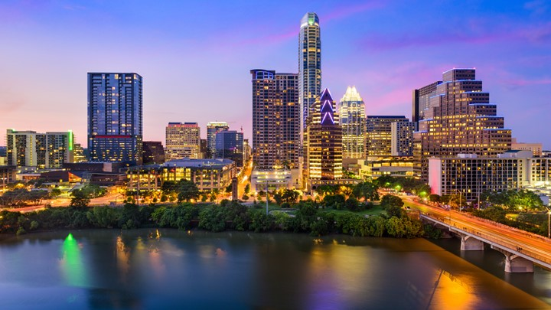
WHAT WE DO
April
2019

Slide 2

PROBLEM
College students may not be fully aware of the city they live in.

Slide 3
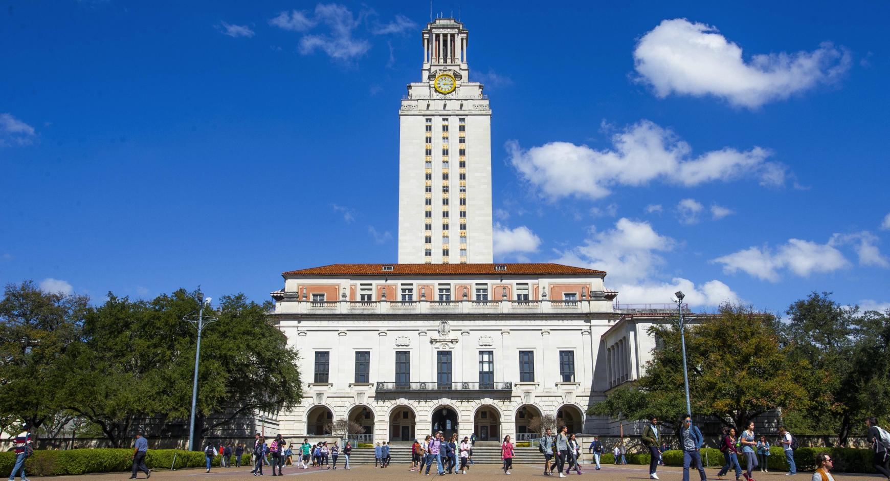
GOAL
To help college students safely connect with their surrounding community and have fun.

Slide 4
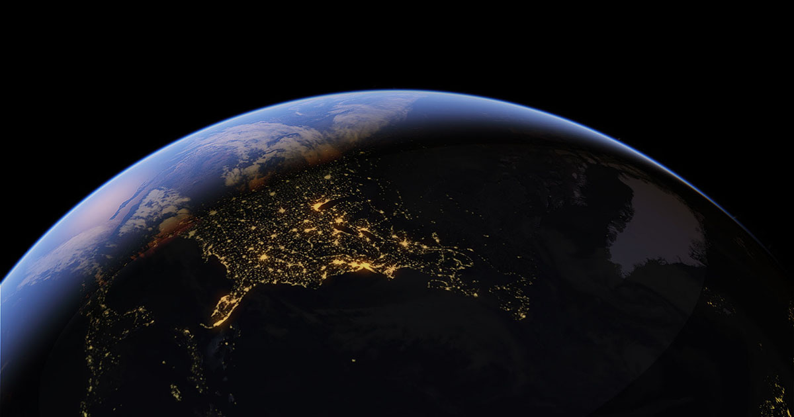


Earth:
56.7 M
US:
19.9 M
UT:
51 K

Slide 5



SOLUTION
Create a website for students to help each other learn more about the city they are in.

